Slide 1
Title IX Update (1.24.24)
Josh McKoon, General Counsel
Technical College System of Georgia

Slide 2
Title IX Statute
“No person in the United States shall, on the basis of sex, be excluded from participation in, be denied the benefits of, or be subjected to discrimination under any education program or activity receiving Federal financial assistance.”
20 U.S.C. 1681

Slide 3
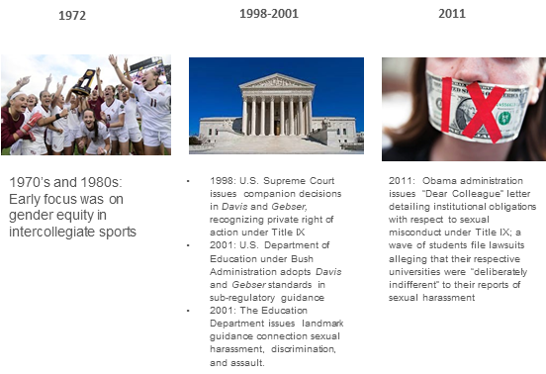
Title IX Timeline

Slide 4
Title IX Timeline (Cont’d)
2011 – 2017
  Respondents begin to file lawsuits alleging that College process is unfair (ongoing)
2020
  May: Trump Administration publishes Final Rule on Title IX Sexual Harassment
  June: Supreme Court issues Bostock decision holding that discrimination on the basis of sexual orientation or gender identity is discrimination “because of sex”
  August 14: Final Rule Takes Effect
  September: All other guidance regarding Title IX withdrawn

Slide 5
Title IX Timeline (Cont’d)
2021-2022
  January: Biden Administration directs Department of Education to review Trump Administration regulations and announces intent to publish a new notice of proposed rulemaking in Spring 2022
  March: Biden Executive Order on Guaranteeing Educational Environment Free From Discrimination on the Basis of Sex (SOGI)
  June: Department of Education issues guidance explaining it will enforce Title IX prohibition on sex discrimination to include SOGI
  December: Department of Education issues advisory that NPRM will move up to April 2022
  June 23, 2022: NPRM issued by Department of Education

Slide 6
Title IX Timeline (Cont’d)
September 22, 2022 – Public Comment Period Closes with over 240,000 public comments submitted
March 2023 – Original target for release of Final Rule
October 2023 – Revised target for release of Final Rule
April 19, 2024 – Final Rule Released by U.S. Department of Education
April 29, 2024 – Attorney General Carr files suit to enjoin enforcement of Final Rule
August 1, 2024 – Deadline for implementation of Final Rule by TCSG

Slide 7

The Sky Is Not Falling
The Final Rule Will Likely Be Issued in March for Implementation later in 2024!

Slide 8
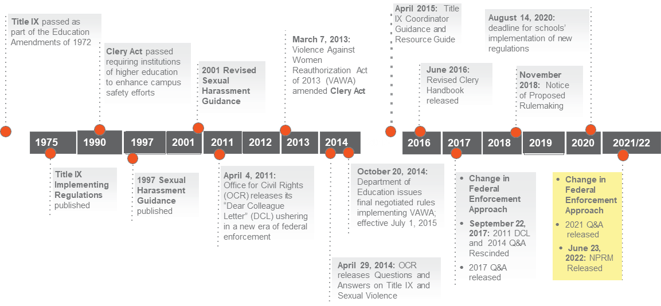
Title IX/Related Authority at a Glance

Slide 9
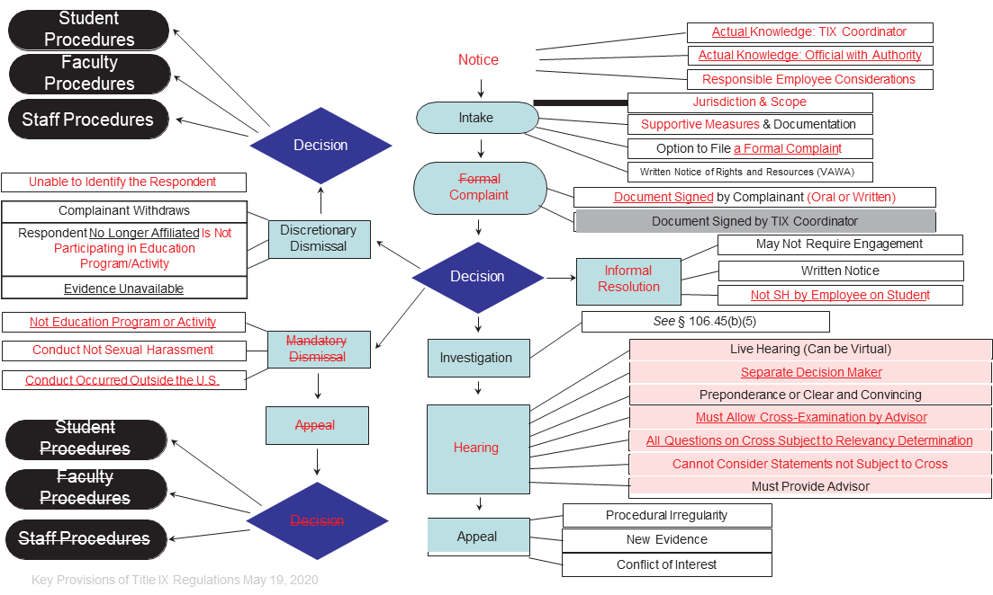
Title IX Obligations: A Diagram

Slide 10
Final Rule – Expanded Scope
Final Rule broadens the scope of:
  Who is protected
What conduct is covered, including:
  All forms of sex discrimination, not just harassment
Expanded definitions of discrimination
Expanded territory covered
Final Rule requires institutions to take prompt and effective action to end any sex discrimination that has occurred, prevent its recurrence, and remedy its effects

Slide 11
Final Rule – Who is Protected?
Students
Employees
Third parties who participated or attempted to participate in the school’s educational program or activity at the time the alleged sex discrimination occurred
Current religious exemptions would apply

Slide 12
Final Rule – What Conduct is Covered?
Sexual harassment
  Quid pro quo harassment
  Hostile environment harassment
Sexual violence
  Sexual assault
  Dating violence
  Domestic violence
  Stalking
Discrimination based on:
  Sex stereotypes or characteristics
  Pregnancy or related conditions
  Sexual orientation or gender identity
  Parental, family, or marital status
Retaliation

Slide 13
Hostile Environment Harrassment
Expanded definition
  “Unwelcome sex-based conduct that is sufficiently severe or pervasive, that, based on the totality of the circumstances and evaluated subjectively and objectively, denies or limits a person’s ability to participate in or benefit from the recipient’s education program or activity”
Current standard
  “Severe, pervasive, and objectively offensive”

Slide 14
Sexual Orientation and Gender Identity
In addition to the general prohibition, the Final Rule:
  Would prohibit differential treatment that causes “more than de minimis harm” in sex-segregated programs or activities
  Specifically references gender identity
Would not amend the regulations governing athletics
  Separate rulemaking planned

Slide 15
Pregnancy or Related Conditions
Final Rule would:
  Cover pregnancy, termination or lactation
  Require same treatment as other temporary disabilities
  Require reasonable modifications, including voluntary leave of absence
  Require notification of Title IX Coordinator
  Require clean and private lactation room

Slide 16
Parental, Family, or Marital Status
Final Rule would:
  Clarify current regulatory prohibitions
  Prohibit pre-employment inquires regarding a job applicant’s marital status

Slide 17
Expansion of Jurisdiction
Final Rule covers all sex discrimination in the program or activity, including conduct that:
  Occurs in a building owned or controlled by an officially recognized student organization
  Is subject to an institution’s disciplinary authority
  Occurs outside the educational program or activity or outside the U.S. if it contributed to a hostile environment within the program or activity

Slide 18
Procedural Obligations
Final Rule details numerous procedural obligations regarding:
  Title IX Coordinator Duties; Supportive Measures;
  Confidentiality; Nondiscrimination Policy
  Training; Informal Resolution;
  General Grievance Procedures; Notice
  Dismissal of Complaints; Investigations; Assessing Credibility
  Sexual Harassment Grievance Procedures;
  Evidence; Hearings;
  Appeals; Enforcement

Slide 19
What’s the Same (Mostly)?
Supportive measures still available:
  May burden a respondent
  Can be appealed
More training requirements
Informal resolution at institution’s discretion
  Now allowed at any point before determination
Access to evidence
  Written summary allowed
Advisors
Emergency removal allowed
Appeals
Retains enforcement standard
Weaker state laws preempted

Slide 20
What’s Different?
Optional live hearing and cross-examination
  Must have process to assess credibility
Single-investigator model allowed
Preponderance of the evidence standard
  Clear and convincing allowed if used in all comparable proceedings
Nondiscrimination policy
Confidential vs. non-confidential employees
No mandatory dismissal
Consolidation of complaints allowed
General requirements for grievance procedures and separate ones for sexual harassment claims involving students

Slide 21
Next Steps
TCSG System Office will collaborate with Title IX Coordinators to begin discussions on these changes and developing training for populations impacted by them
Prepare and circulate changes to TCSG Procedure 6.1.2p and other relevant TCSG Policies and Procedure to be in compliance
Monitor Court Action for change in implementation schedule/other changes

Slide 22
Additional Resources
U.S. Department of Education Summary of Key Provisions of the Final Rule:
https://www2.ed.gov/about/offices/list/ocr/docs/t9-final-rule-summary.pdf
U.S. Department of Education Fact Sheet on the Final Rule:
https://www2.ed.gov/about/offices/list/ocr/docs/t9-final-rule-factsheet.pdf
U.S. Department of Education Fact Sheet on Title IX Athletics NPRM:
https://www.ed.gov/news/press-releases/fact-sheet-us-department-educations-proposed-change-its-title-ix-regulations-students-eligibility-athletic-teams

Slide 23

Questions?

